Slide 1



CRISPRing
Thomas Jacobs
Lab website: https://jacobslab.sites.vib.be/en#/
Vector collection: https://vectorvault.vib.be/

Slide 2
Introduction

Slide 3
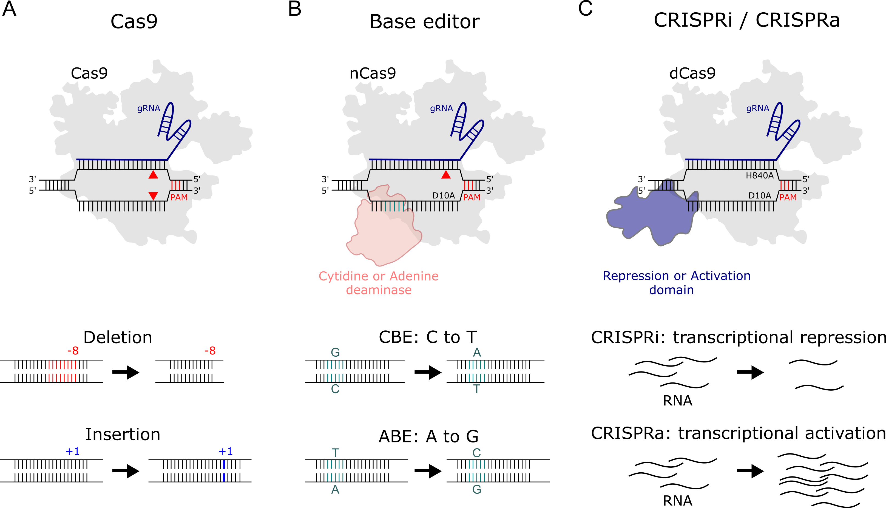
CRISPR-Cas9 is a DNA endonuclease
2-component system
20-nt target in a 100-nt RNA molecule (gRNA)
Cas9 is one of several nuclease systems

Slide 4
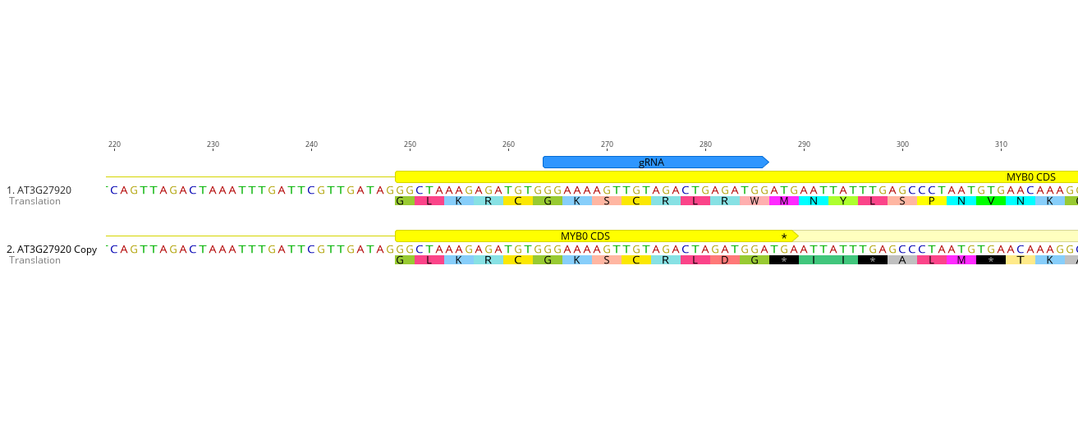
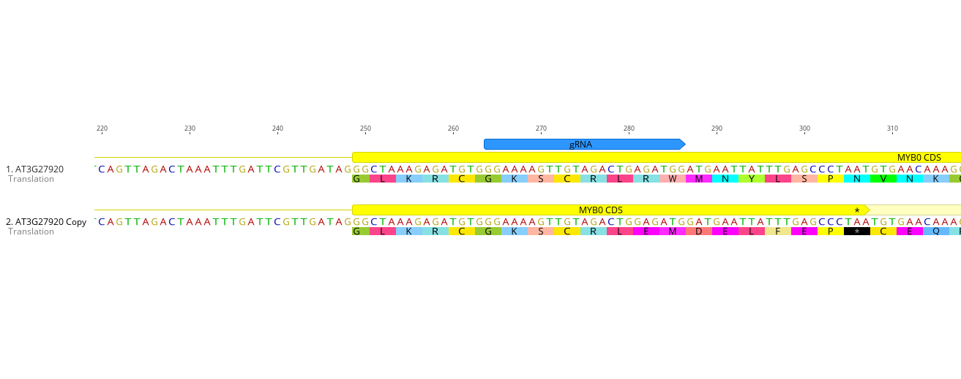
Making knockout (KO) mutants
CDS
intron
DSB
Non-homologous end joining
NHEJ
Indels
Nonsense
mediated
decay
NMD
-1
+1

Slide 5
PAM= protospacer adjacent motif
Cas9 PAM is NGG
Limits target sites
DSBs are made between 3rd and 4th bp upstream
NNNNNNNGG
NNNNNNNCC

Slide 6
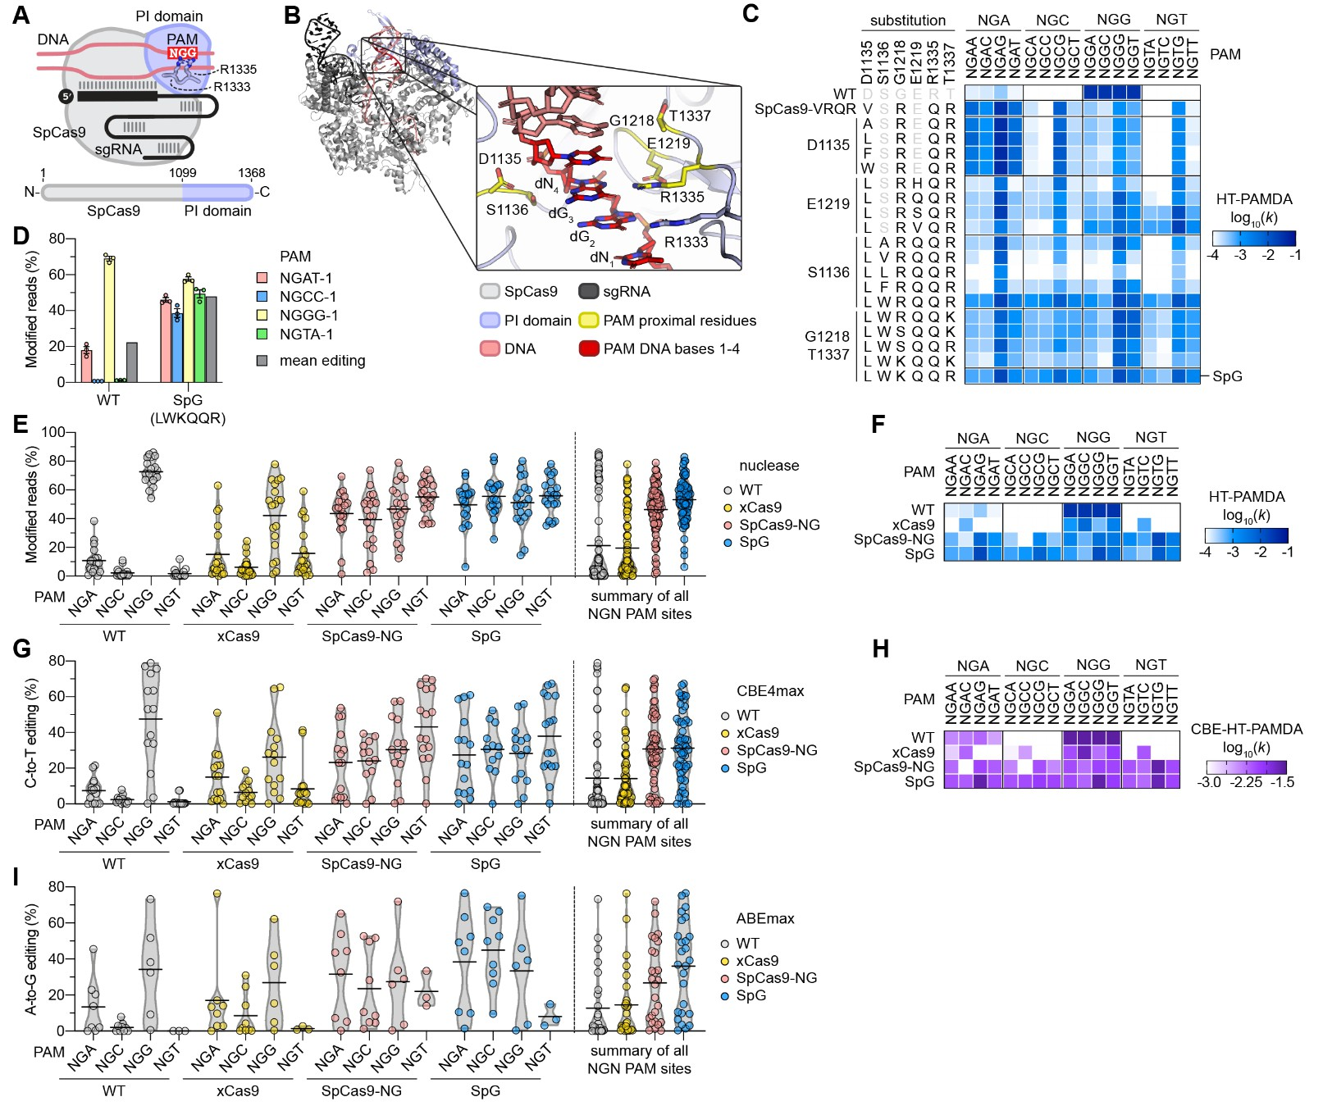
Cas variants engineered for relaxed PAMs
But… generally less efficient
78 “real” target sites
Walton et al. 2020

Slide 7
Cas9 contains two nuclease domains
Nickase variants
  RuvC = D10A
  HNH = H840A
RuvC
HNH

Slide 8
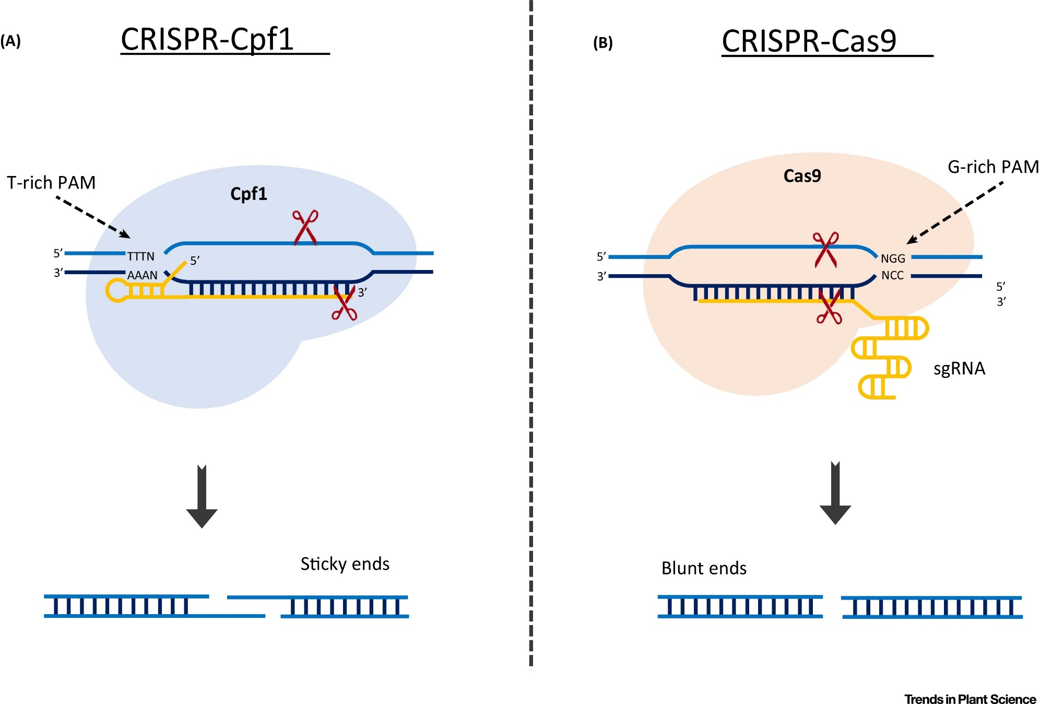
Cas12a (formerly Cpf1) complements Cas9
Cas9
Cas12a

Slide 9
guide RNAs (gRNAs)
Please don’t call them sgRNAs

Slide 10
Anatomy of a gRNA– Cas9
Deletions
Protospacer
Blunt DSB
PAM
Target locus
5’-GACCCGCGCCGAGGTGAAGTTCGAGGGCGACACCCTGGTGAACCGCATCGAGCTG -3’
3’-CTGGGCGCGGCTCCACTTCAAGCTCCCGCTGTGGGACCACTTGGCGTAGCTCGAC -5’
GAAGTTCGAGGGCGACACCC
5’- G
- scaffold
Mismatches tolerated
Transcription
Target sequence: N₂₀NGG
Spacer length can vary: N₁₇₋₂₁NGG
Pol III
U6/U3
Pol III
terminator
Spacer
Scaffold
-TTTTTT

Slide 11
Anatomy of a gRNA– Cas12a
Protospacer
4-5 nt 5’ overhang
PAM
Target locus
5’-GAGACTTCTGATCGAACATTTCTTGGACGCTAATAACACGGTATGGATCTCTTCA -3’
3’-CTCTGAAGACTAGCTTGTAAAGAACCTGCGATTATTGTGCCATACCTAGAGAAGT -5’
TTGGACGCTAATAACACGGTATG
5’- scaffold
Mismatches tolerated
Transcription
Target sequence: TTTVN₂₃
Scaffold
Spacer length can vary: TTTVN₂₀₋₂₄
Promoter
Spacer

Slide 12
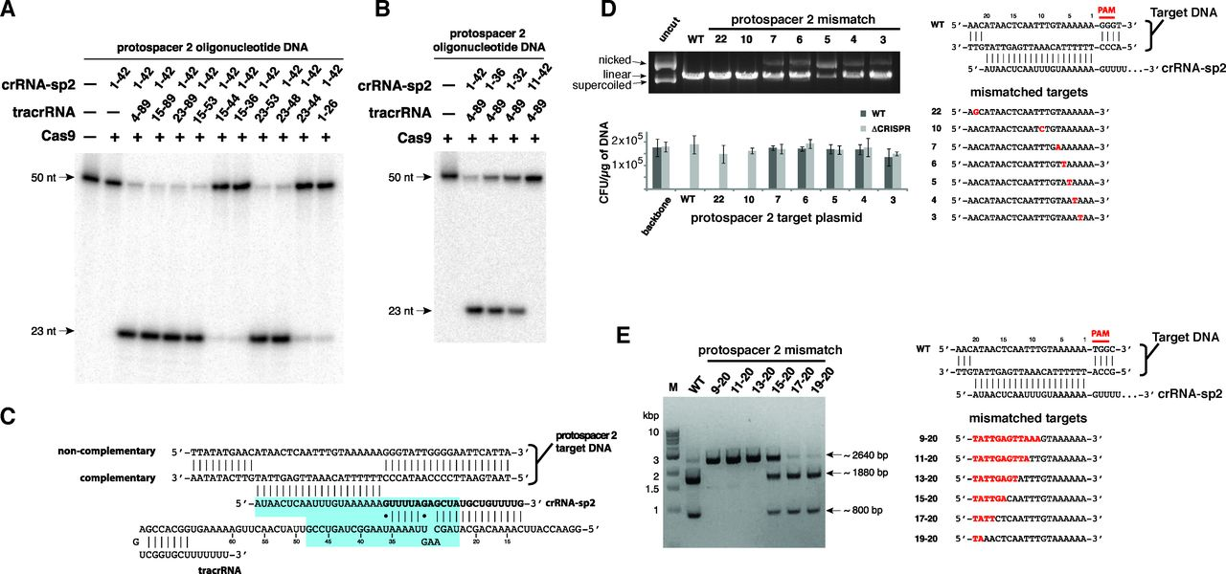
Off targets
How many mismatches are tolerated?
  5’ mismatches tolerated, similar to primer design
  Suggests ‘seed’ region
Target
Cleavage products
Jinek et al. 2012

Slide 13

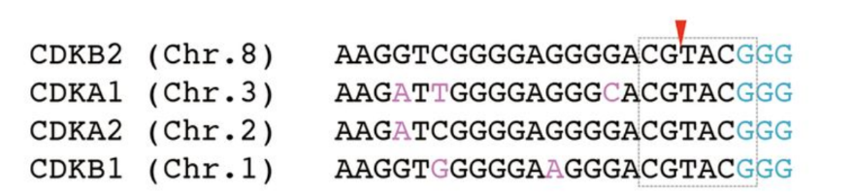
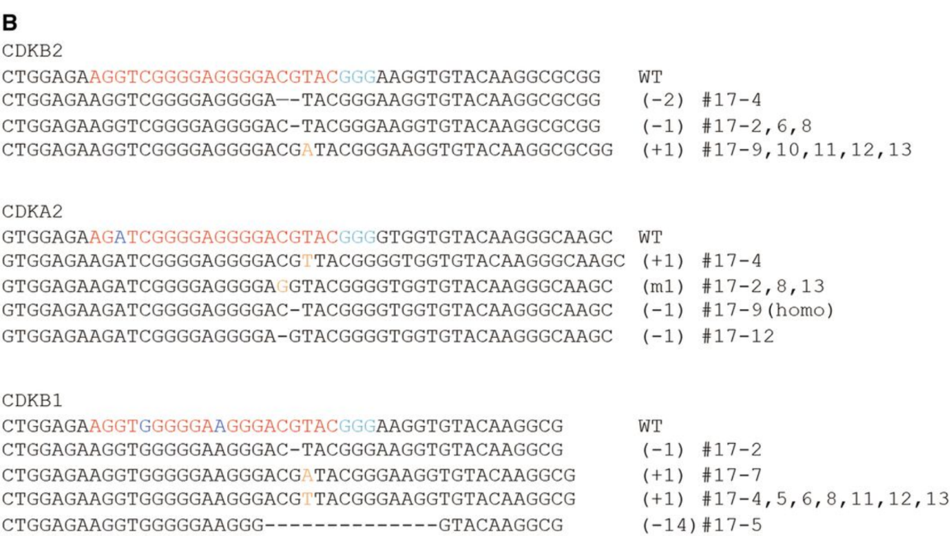
Off targets are not necessarily bad
Produce indels

Slide 14
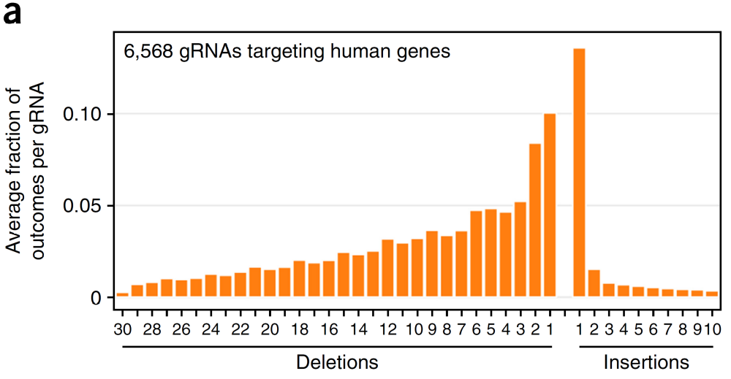
DNA repair is non-random
Allen et al 2018
PMID: 30480667

Slide 15
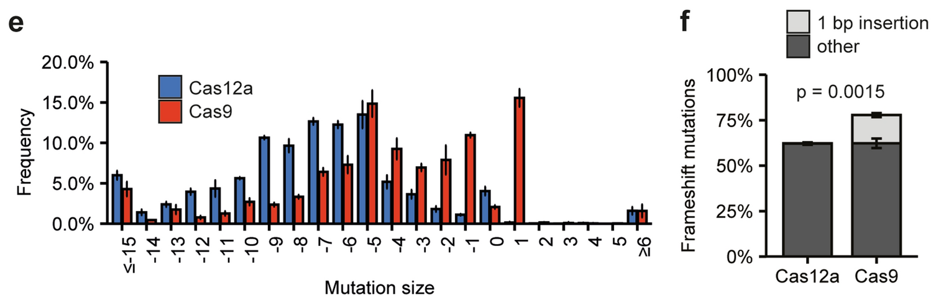
Notes:
https://www.nature.com/articles/s41598-024-55088-4

Slide 16
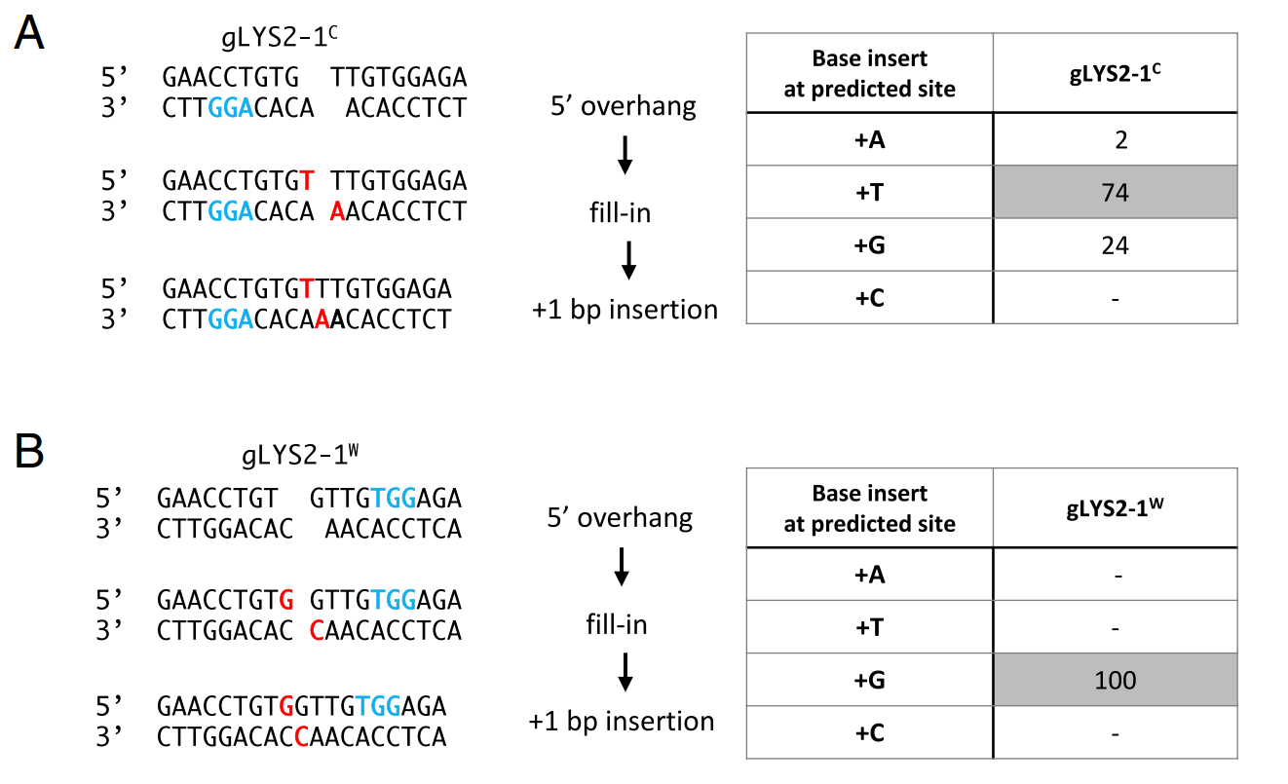
Cas9 creates a 1-nt, 5’ overhang
Lemos et al., 2018
PMID: 29440496

Slide 17
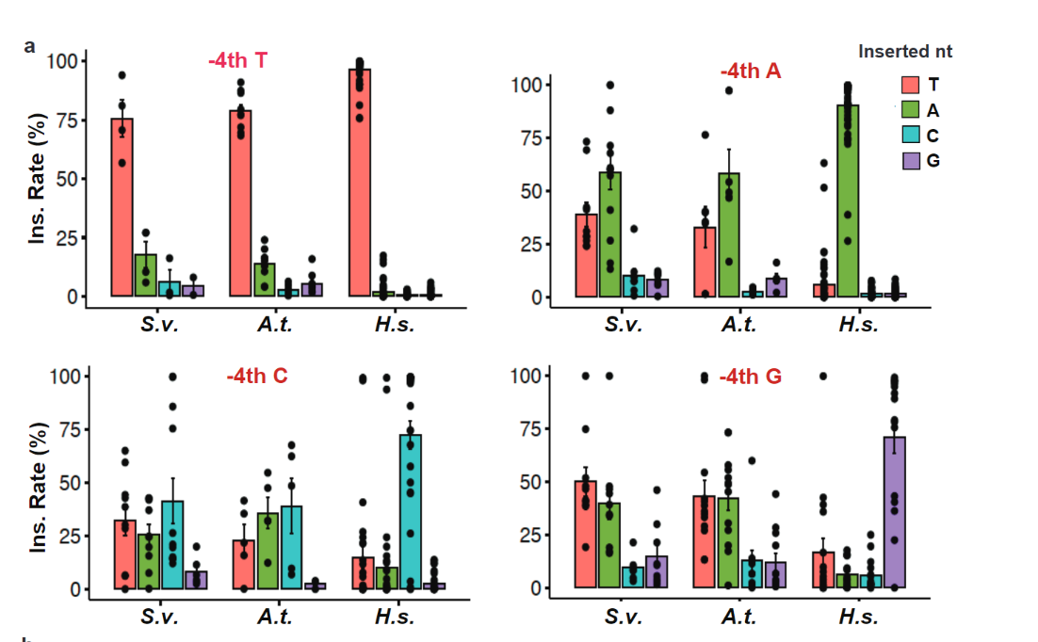
The 4th position duplication is not so straightforward in plants
Notes:
https://www.nature.com/articles/s41467-024-50676-4

Slide 18
Cloning gRNAs

Slide 19
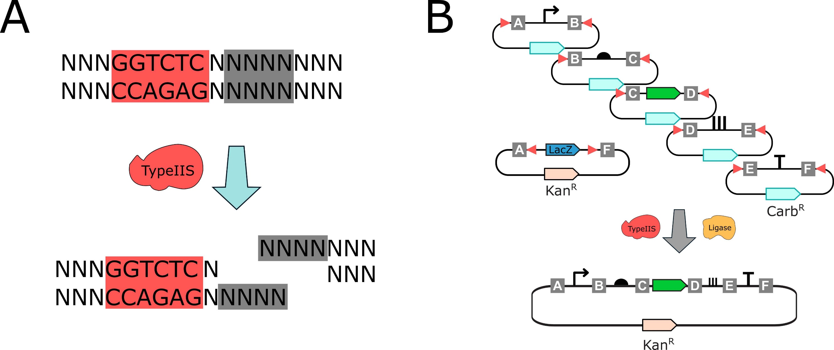
Golden Gate Assembly uses Type IIS REs
dx.doi.org/10.17504/protocols.io.x54v9yr3mg3e/v1

Slide 20
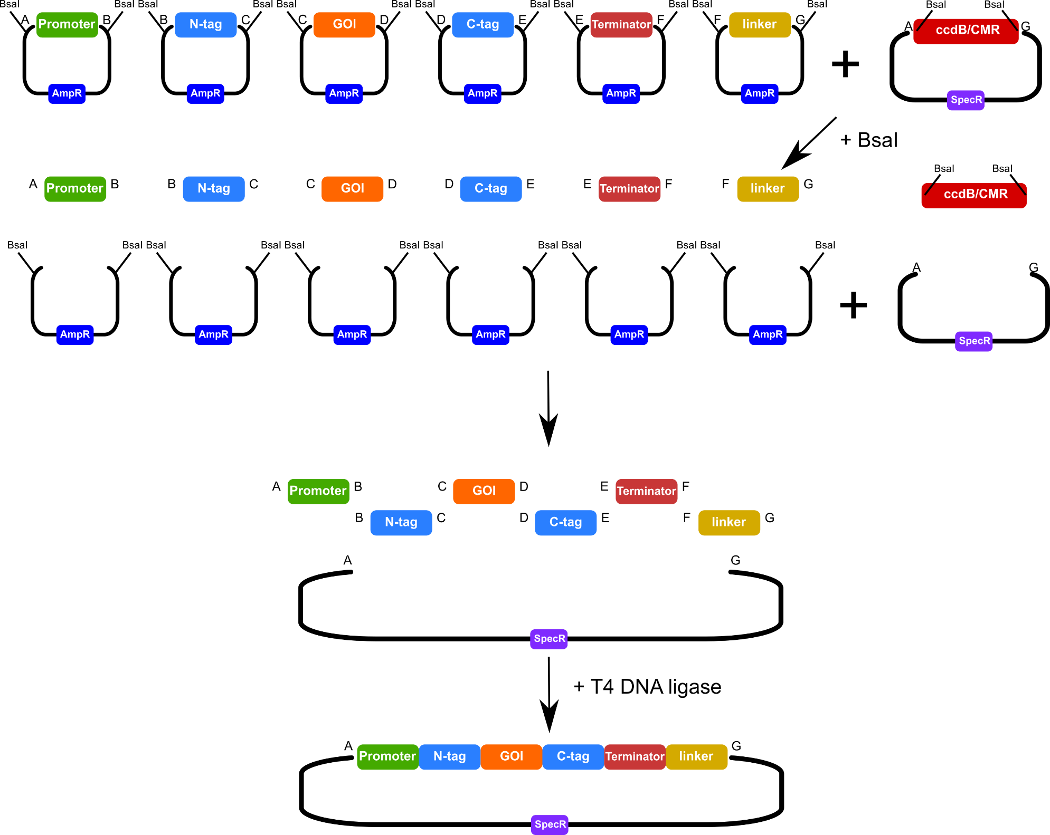

Slide 21
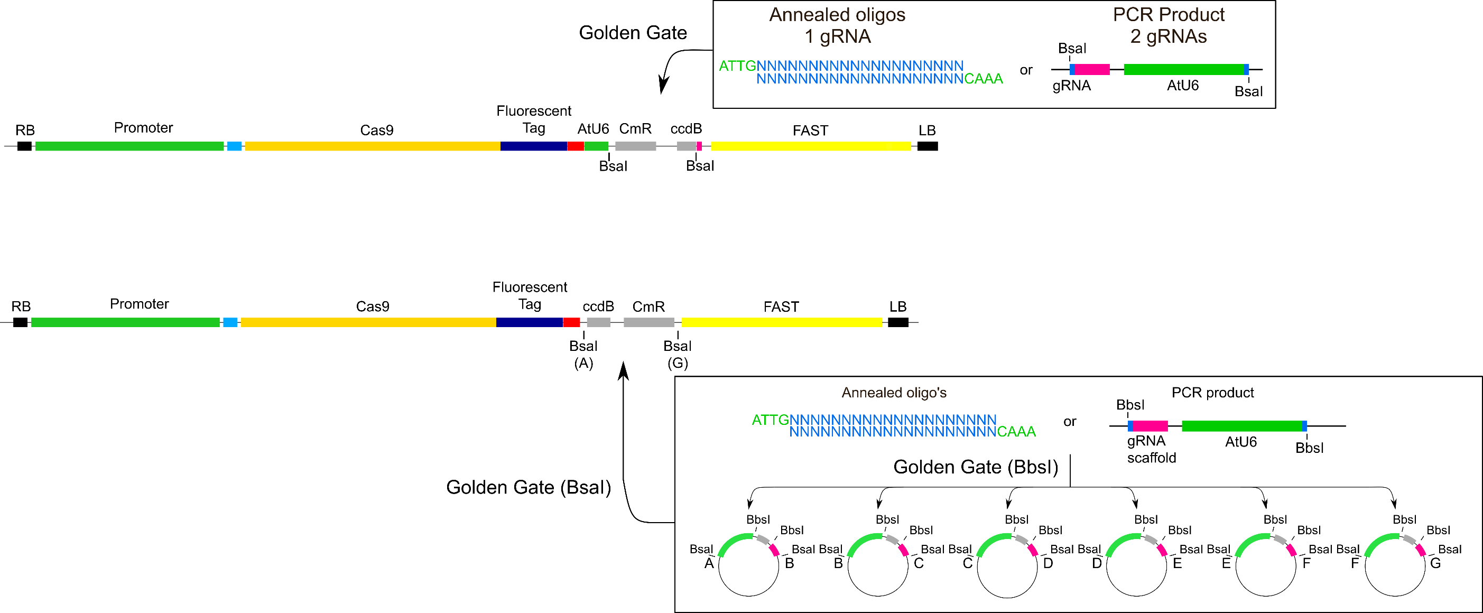
The ideal CRISPR vector
Fluorescent markers
Positive selection (T0)
Negative selection (T1)
Negative selection in E. coli
Type IIS restriction site for Golden Gate assembly of gRNAs
Pay attention to the DNA ends
Always check you assembly in silico before ordering primers!!

Slide 22
Cloning >2 gRNAs requires 2 steps
Clone gRNAs into ‘entry’ vectors
Sequence validate in entries
  Sanger on gRNA arrays is challenging

Slide 23
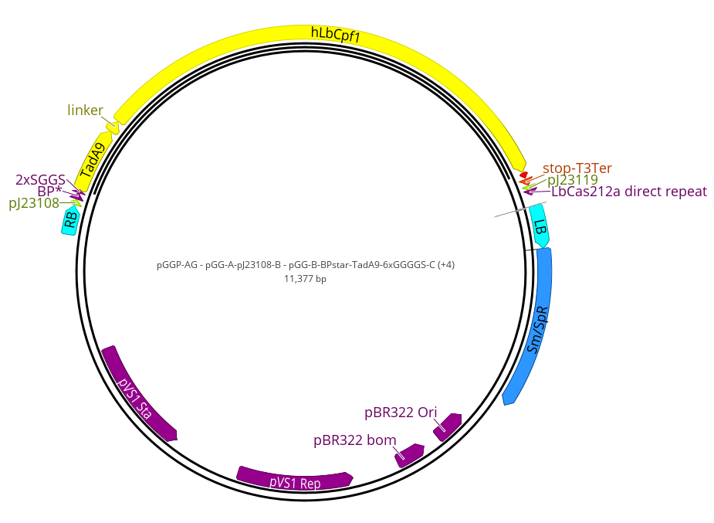
Step 2: LbCas12a-ABE assembly
Component | Amount | Volume (µL)
pGG-A-pJ23108-B | 100 ng | 1
pGG-B-BPstar-TadA9-6xGGGGS-C | 100 ng | 1
pGG-C-hLbCas12a(D832A)-D | 100 ng | 1
pGG-D-Linker-E | 100 ng | 1
pGG-E-stopT3Ter-F | 100 ng | 1
pGG-F-pJ23119_LbCas12aDR_target-G | 100 ng | 1
pGGP-AG | 100 ng | 1
10X CutSmart Buffer | 1X | 1.5
10 mM ATP | 1 mM | 1.5
T4 DNA ligase | 200 U | 0.5
BsaI | 5 U | 0.5
MQ water |  | 4
 |  | 15
37° C | 3 min | 30 X
16° C | 3 min
50° C | 5 min
80° C | 5 min
12° C | ∞

Slide 24
Base editing

Slide 25
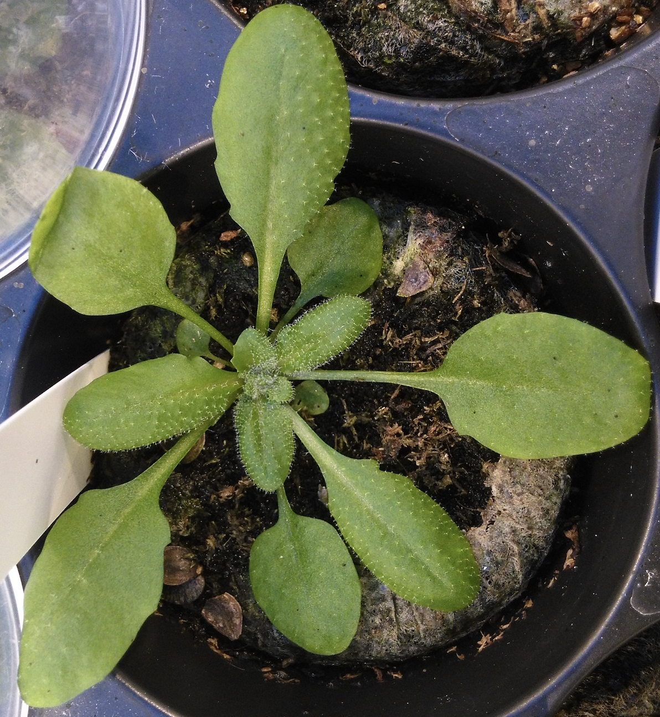
NHEJ has limited repair outcomes
Indels
Nonsense
mediated
decay
NMD
-1
+1
Knockouts are great up to a certain point
  What to do with essential genes?
  How can we generate gain-of-function alleles?
To study gene function we really want
  SNPs
  Targeted insertion/replacement

Slide 26
Base editing vs. standard CRISPR
Gaillochet et al., 2021

Slide 27
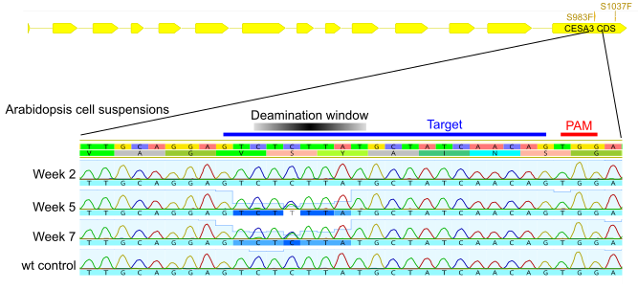
Base editors edit within targeting “windows”
Hu et al 2019

Slide 28
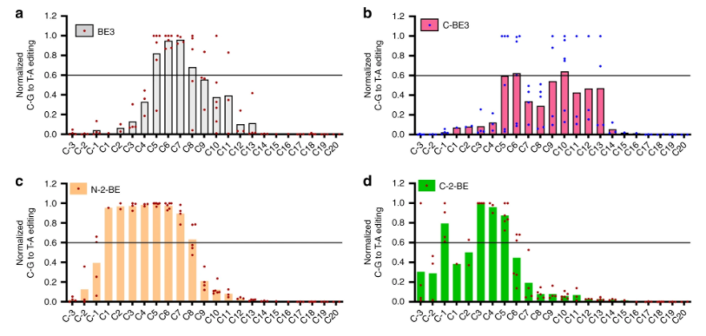
Different deaminases have different editing windows
Cheng et al 2019
https://doi.org/10.1038/s41467-019-11562-6

Slide 29
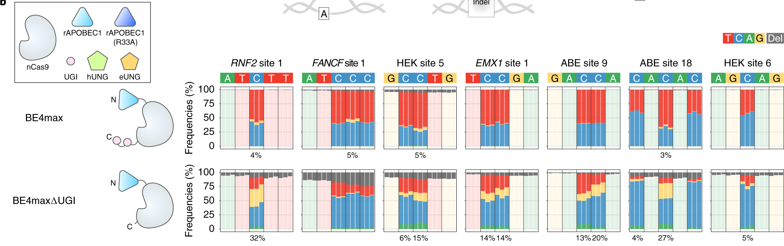
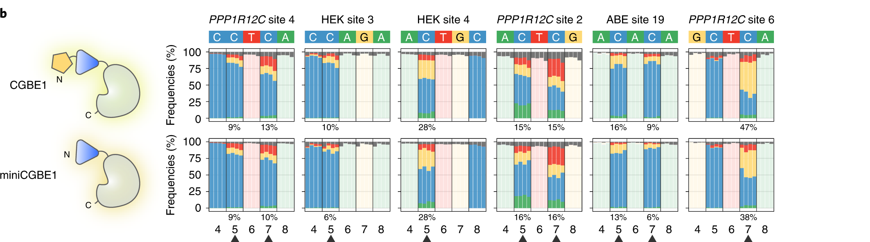
C-to-A and C-to-G editors
Some optimization still required…
Kurt et al., 2021
PMID: 32690971

Slide 30
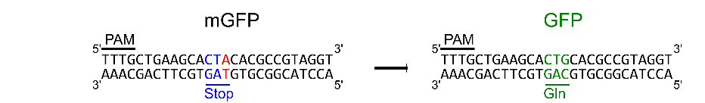
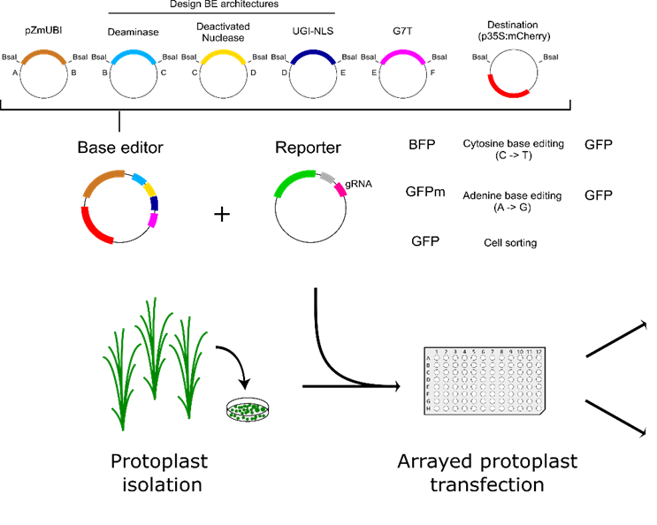
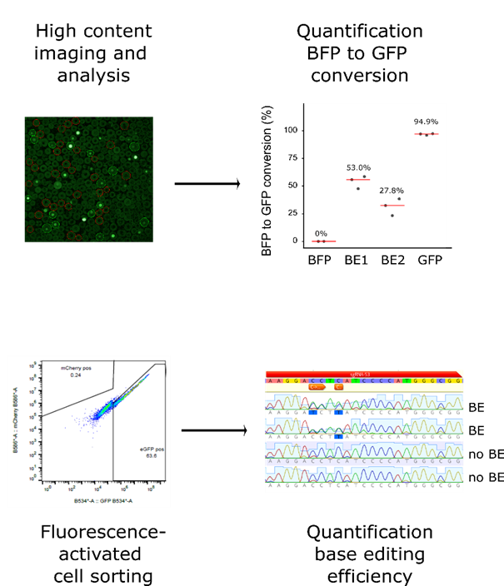

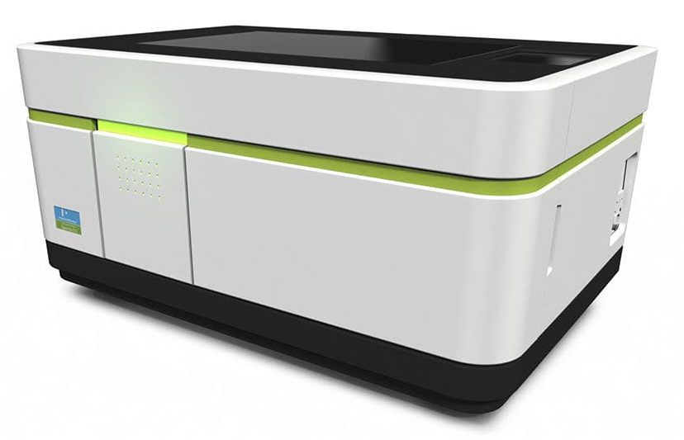

Systematic optimization of Cas12a base editors
~3 weeks
VIB Screening Core
VIB Flow Core
Gaillochet et al., 2023
Notes:
Define base editing

Slide 31
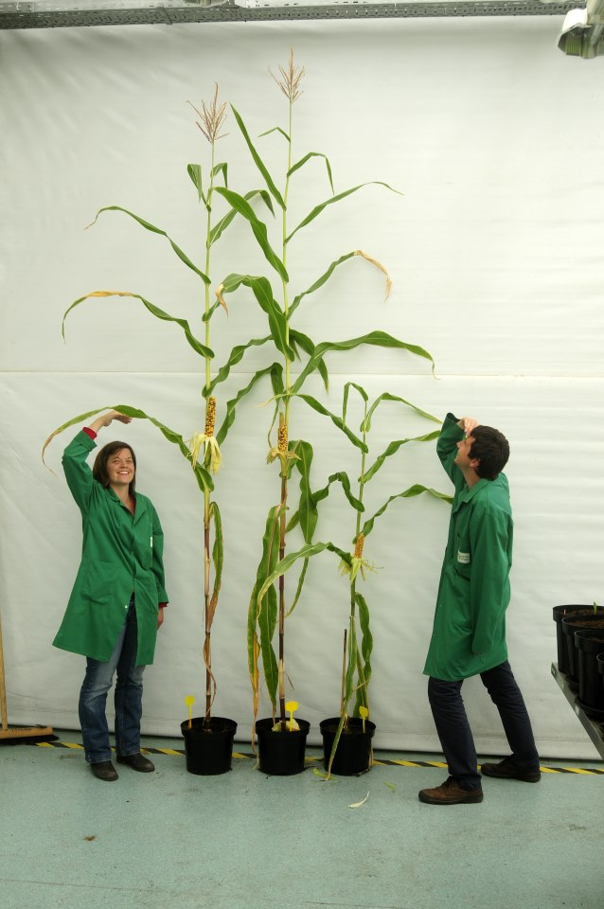
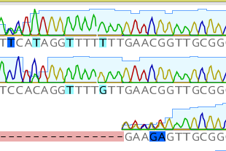

Translating into stable maize–results differ from protoplasts
PAM
1
5
9
15
CACAGGCTTTCTTGAACGGTTGCGG
Vector | # plants | # T0 plants mutated | C→T | C→G | C→A | indels
Base editor 1 | 6 | 100% | 50% | 50% | 0% | 50%
Base editor 2 | 24 | 96% | 42% | 25% | 0% | 58%
Base editor 3 | 31 | 100% | 23% | 19% | 3% | 80%
Protoplasts only produce C to T mutations
  Cell-type specific base editing profiles?
Promoter bashing?
Gaillochet et al., unpublished

Slide 32
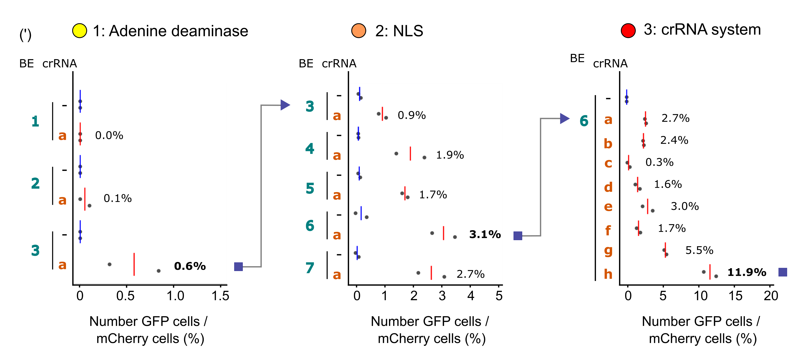
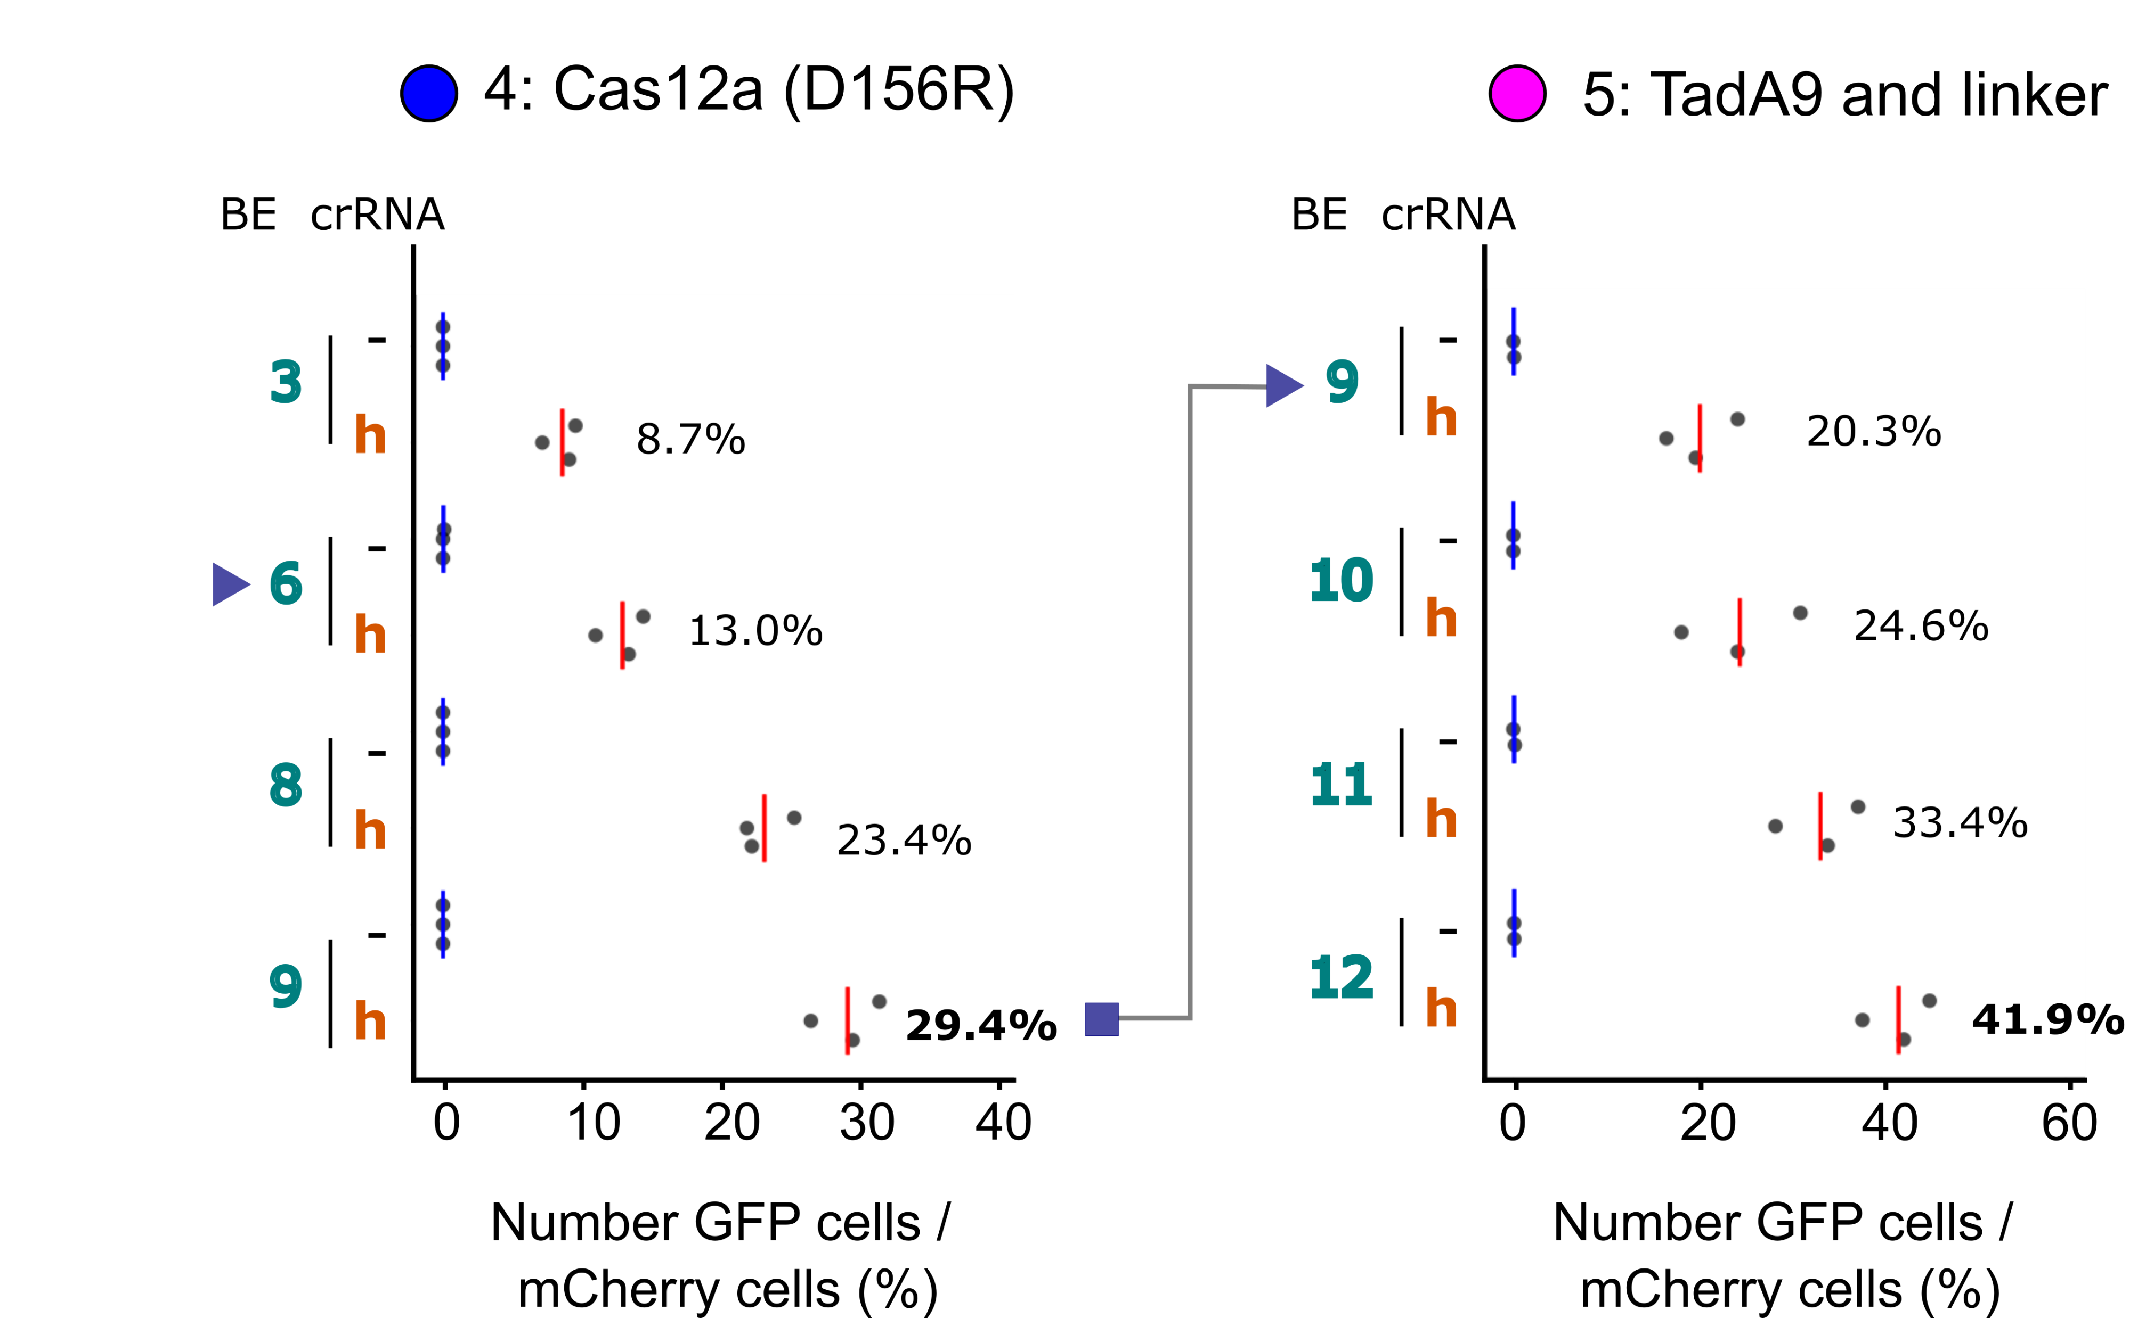
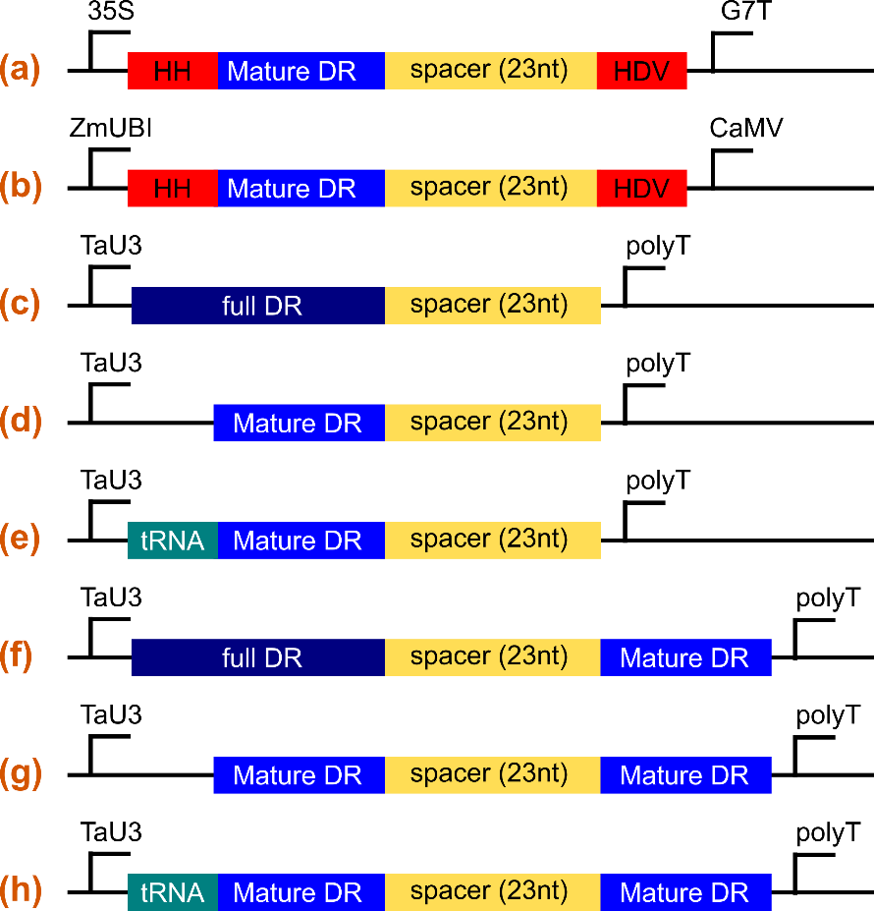
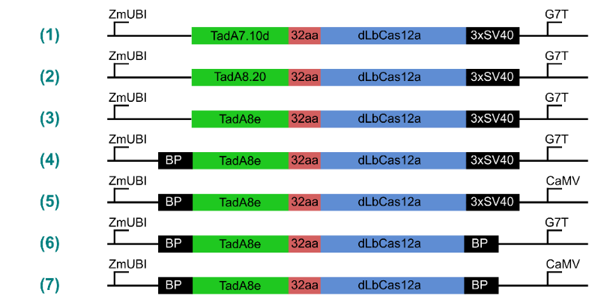
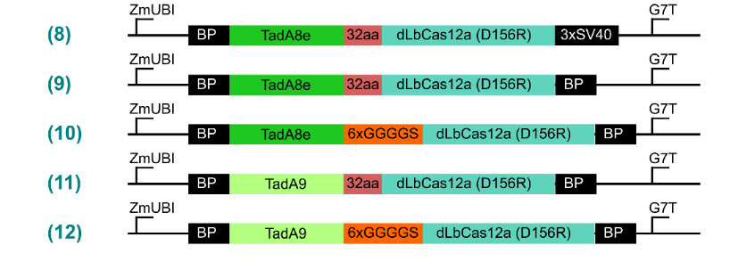
Iterative optimization campaign for Cas12-ABE
Gaillochet et al., 2023

Slide 33
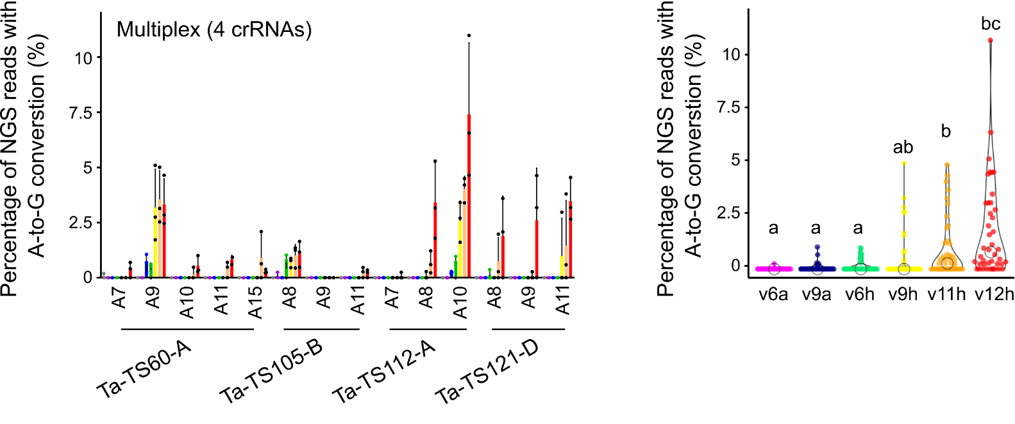
Cas12a-ABEs edit endogenous sites
Off-targets
(Kruskal-Wallis,
Dunn post-hoc p<0.05)

Slide 34
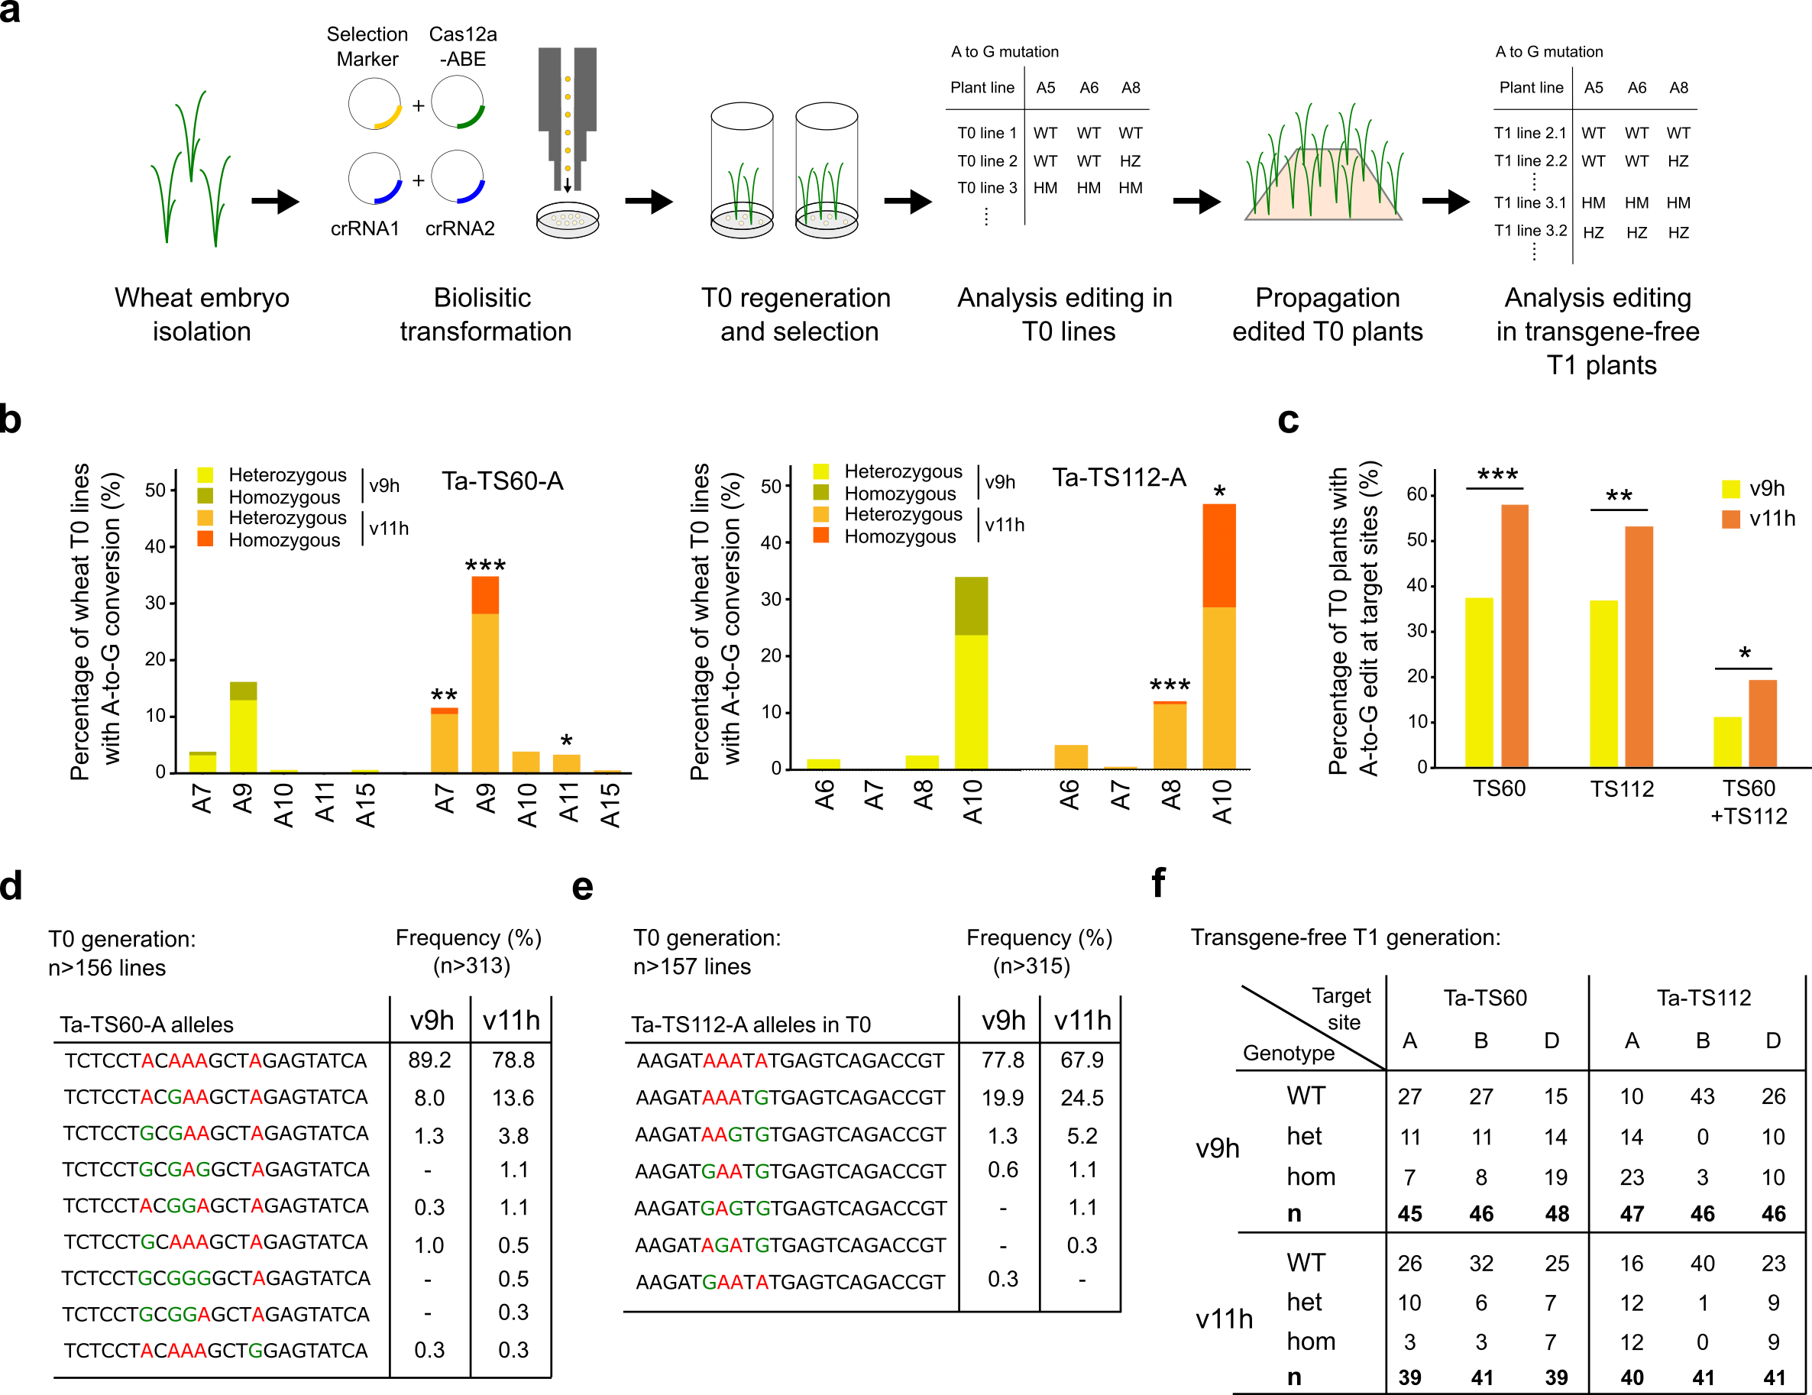
Base edited alleles transmitted to 22 out of 24 progeny

Slide 35
Target design

Slide 36
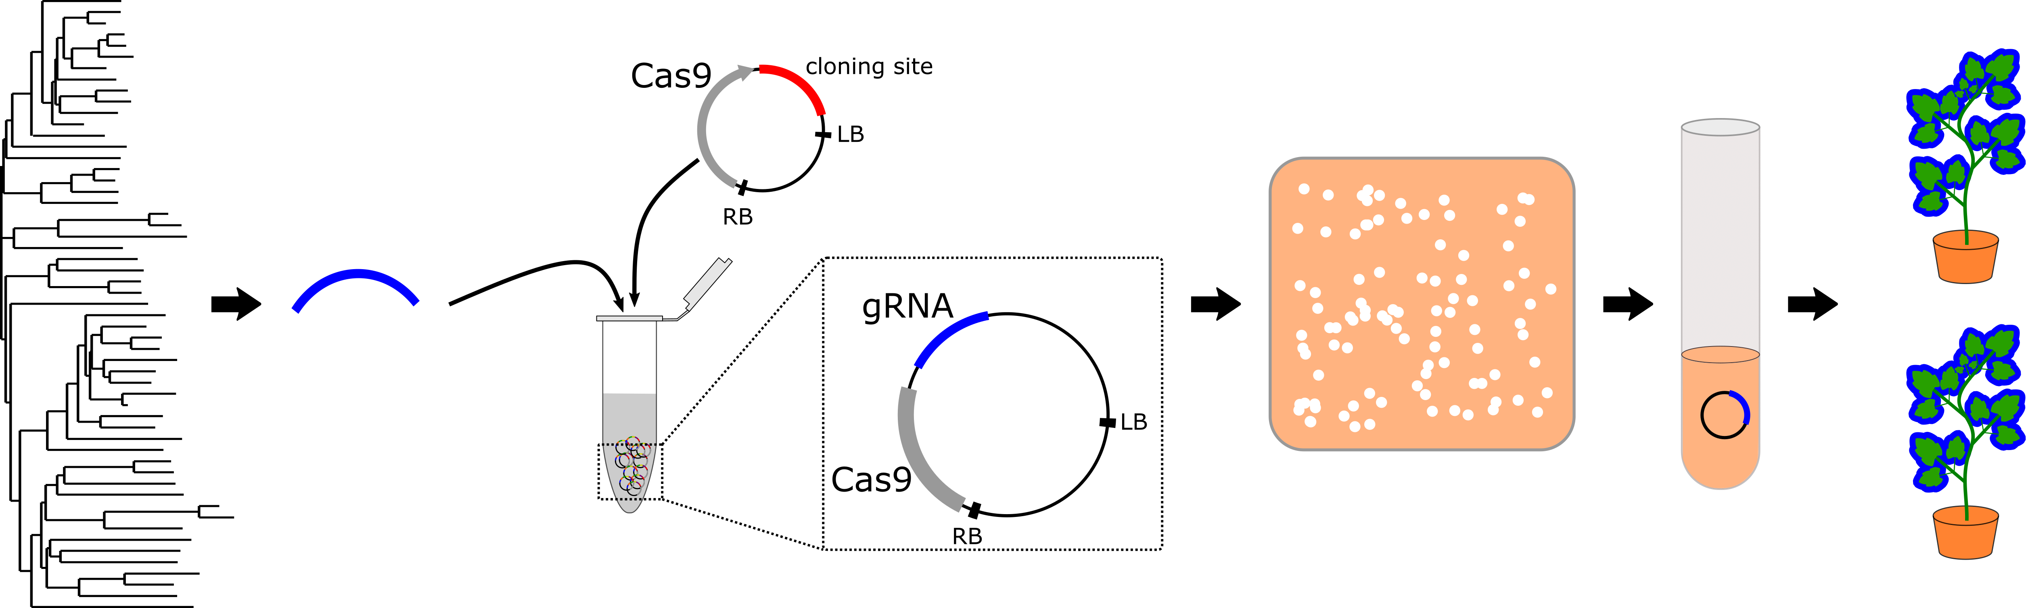
Designing the best CRISPR experiment: Start at the end
Gene target selection
Cloning
Transformation
Genotyping
GTGGTACGT
+1
Oligos = gRNAs
Phenotyping
GTG--ACGT
-2
What is your goal?
What do you need for that goal?
  Specific variants?
  True-breeding lines?
  Populations of plants/cells with mutations?
What is your reference sequence?
Cloning : ~10 hours
Genotyping: 100s of hours

Slide 37
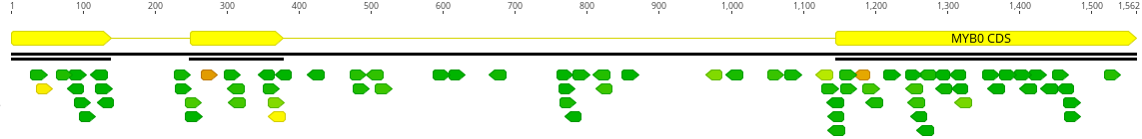
Which gRNA(s) do we use?
CDS
intron
Remember to ask: What is my objective?
For a simple KO
  Target critical domains (if known)
  OR Target the middle of the gene (we use 60%)
    NMD requires stop codon before last intron
    5’ mutations might have alternative start (ATG) codons
Target regions that are easy to genotype
77 Cas9 gRNAs

Slide 38
Genotyping methods
Unbiased
  Whole genome sequencing (Illumina, PacBio, Nanopore…)
  In theory, can detect any mutation anywhere compared to reference
  Not simple in practice given background mutation rates and sequencing errors
    Specific controls needed to do this well
Biased (e.g. PCR)
  Pretty much all genotyping methods we use to evaluate gene editing are biased, i.e., use PCR
  It is not possible to PCR amplify every sequence in a genome
  This sets up 2 rules:
    1. If you cannot PCR it, why mutate it? You will never know what you made
    2. Set up the PCR assay first, before doing anything else (cloning and transformation)

Slide 39
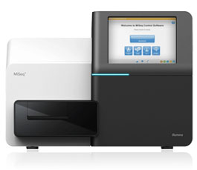
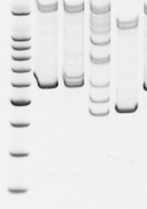
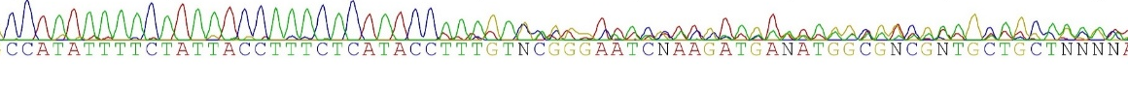


Genotyping workflow
DNA extraction
Δ-3
wt
Alleles present
PCR amplify target gene
Mixture of amplicons
Amplicon sequencing
Sanger sequencing
Heteroduplex analysis
ICE

Slide 40
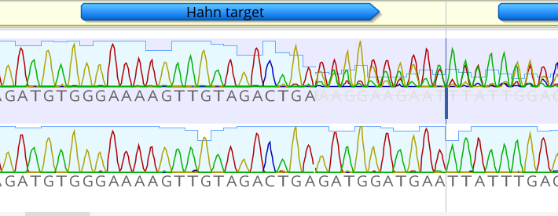
Example of Sanger chromatogram with overlapping peaks
Sensitivity ~20%
Fast (next day)
Quantitative with online programs, allele determination
Bread and butter in my lab
Take care! There are a lot of errors that can also result in overlapping peaks

Slide 41
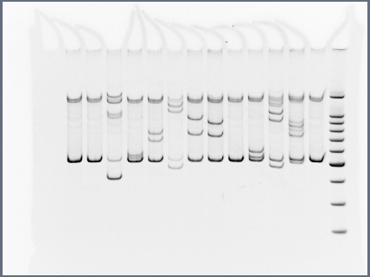
Example of heteroduplex retention using polyacrylamide gel electrophoresis
Sensitivity ~10%
Fast (half a day?)
Qualitative: mutant or not
I did a lot of these as a postdoc, limited scale by gel rigs, not every amplicon gives such clear bands
Independent events
wt
∆
∆
∆
∆
∆
∆
∆
∆
∆
Heteroduplexes
Homoduplex
15% Polyacrylamide gel

Slide 42
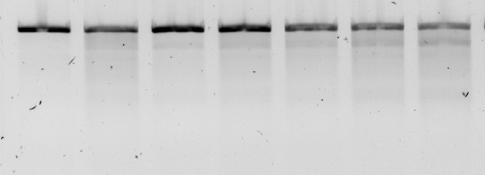
Example of heteroduplex analysis using T7E1 or CAPS
Sensitivity ~10%
Fast (half a day)
Quantitative (% mutated), no sequence information
Quantifying requires getting a good gel.
Days after co-cultivation
0
2
4
7
9
11
14
Homoduplex
Cleaved
Cleaved
2
9
7
9
13
20
24
% Gene
modification
% Gene modification =
100 x (1 – (1- fraction cleaved)^{1/2})
Guschin, D.Y., et. al.(2010)

Slide 43
Method | Information | Sensitivity | Sample cost | TAT | Advantages | Limitations | When to use
Sanger sequencing and TIDE/ICE | Quantitative, DNA sequence | ~10% | Sanger + cleanup | 2 | -Easy -Inexpensive -Great value -Batch (ICE) | -Not all amplicons or mutations | -Stable mutant plants -Cell populations -Medium samples
Clone and sequence | Semi-quantitative, DNA sequence | How much $ you got? | Cloning + multiple Sangers + cleanup | 3 | -No special equipment -Reliable -Multiplexing | -Slow -Hands-on time -Limited info. | -Few samples
Heteroduplex retention (PAGE) | Qualitative (can quantify), no DNA sequence | ~10% | PCR and gel | 1 | -Fast -Can ID specific alleles | -Does not scale -Some amplicons don’t work | Looking for specific mutant in various lines
T7 Endonuclease I or similar (heteroduplex) | Quantitative, no DNA sequence | ~5-10% | $3.40 ~$2.50 enzyme | 1 | -Fast -Somewhat quantitative -Works for most amplicons | -Hands-on time -Some opt. required | -Cell populations -Fast turnaround
qPCR/ddPCR | Quantitative, specific allele | 0.01%-- depends | ~6 euro | 1 | -Fast -quantitative -very sensitive | -Setup time -difficult to scale | -Have very specific repair product in mind AND it is rare in population
Illumina sequencing | Quantitative, DNA sequence | 0.1-1% | Depends on scale… cents | 7-21 | -Can scale -Simple workflow -Power -Multiplexing | -Small amplicons (llumina) -Slow if using service | -Cell populations -A lot of samples
Nanopore (under development) | Quantitative, DNA sequence | ?? | 15 euro for ~500-2000 reads, higher scales possible | 5 | -Can scale -Simple workflow -Multiplexing -Longer amplicons than Illumina, can be several KB) | -Currently high error rate -Analysis methods not well developed | -Cell populations -Complex editing (e.g. promoter bashing) -Pre-testing Illumina amplicons (saves time)

Slide 44
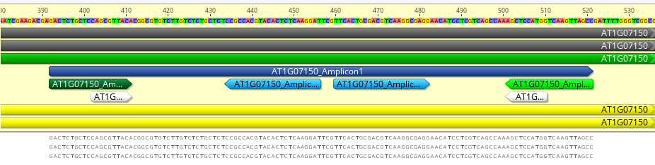
Target design and genotyping are linked
Amplicon
Considerations
Analysis method
  e.g. Sanger vs NGS
Spacing primers and gRNAs
  Large deletions destroy primer binding sites
primers
gRNAs
 | y | x
Sanger | Min 200 Max 600 | Min 400 Max 800
NGS (2x150) | Constrained by x, 15 bp is good compromise | ≤280 bp to merge reads
y
x

Slide 45
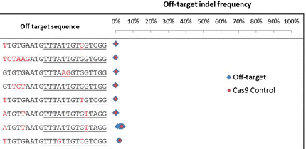
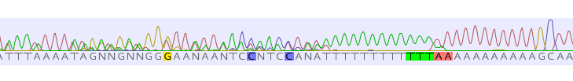
Test your genotyping assay before doing anything else
Select gRNAs within ‘clean’ amplicons free of artefacts
Sanger
Target
NGS
Deterioration of read
  Introns and UTRs often have homopolymers (>10 repeated base) that cause overlaps in chromatograms
Homopolymers
~4% background
The cut site is still ~200 bp upstream
Jacobs et al., 2015

Slide 46
Hands-on session
Choose 1 gene from the Arabidopsis genome
Choose 1 CRISPR technology
  Indel, base editing
Choose 1 enzyme
  Cas9 or Cas12a
Choose sample type
  Plant (and generation) or cells
Choose analysis method
  Any of the above
Design a good gRNA
Defend your gRNA
  What is the expected DNA repair product?
  What is the expected mutation frequency?
  Are there off-targets?

Slide 47
Indel analysis

Slide 48

Germline
Cas9+
Cas9-
T1
T0
FAST+ seeds
FAST- seeds
T2
Somatic & germline
Somatic vs germline mutations
Develtere et al., 2023
https://doi.org/10.1111/tpj.16785

Slide 49
Questions to ask yourself, before your PI does
What will you keep?
  Any indel or a specific allele? Combinations of alleles?
What will you sample?
  Plants w/ CRISPR components? (clonally propagated)
  Plants w/o CRISPR (null segregants / transient delivery)
  Cells
When will you sample? (numbers multiply by generation)
  How many can you sample? Time and cost
What is the expected mutation frequency? Use the right technology
  What proportion of cells are mutated? Think about sensitivity
  Somatic edits
  Pools of cells

Slide 50
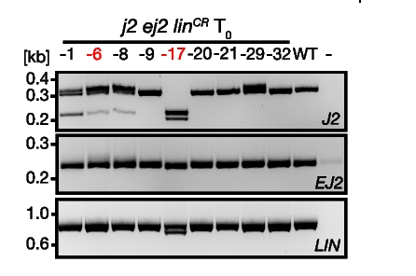
What your PCR should will look like
Every PCR experiment contains… always
  WT control
  No-template control
Alonge et al., 2022

Slide 51
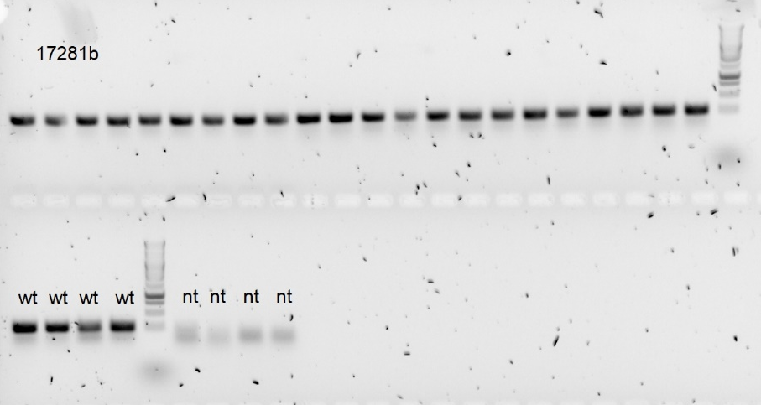
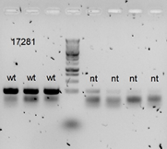
Bands in blanks… is a never ending struggle
We spend a lot of time dealing with contaminated PCR
If your PCR is contaminated, your gene editing estimate will be inaccurate/wrong
I don’t know the solution
Take care, use controls and best practices

Slide 52
Hands-on indel detection session

Slide 53
4 datasets
  Sanger
    Plants: T1 tomato plants, T-DNA segregating
    Cells: Arabidopsis cell suspensions
  Illumina
    Plants: T2 Arabidopsis plants, null segregants
    Cells: Arabidopsis cell suspensions
Objective: determine the genotype frequencies using combination of Geneious and online programs
  Sanger: https://ice.synthego.com/#/
  Illumina: http://crispresso2.pinellolab.org/submission
  Also a sample key with file names for samples and controls
You have all necessary data
  Sanger: download the template file from synthego and fill it out
  Illumina: drag and drop
Notes:
https://doi.org/10.1104/pp.17.00489
https://doi.org/10.1111/tpj.16785

Slide 54
Steps for evaluation
Drag and drop sequences in Geneious
  Align to reference sequence
  Do the sequences make sense?
  Can you already see obvious mutants?
Analyze with software
  Do the controls make sense?
  Do the repair products make sense? (think about 3-4 position)
  Do the allele frequencies make sense?
Today’s task
  What fraction of cells are mutated?
  What alleles are generated?

